Slide 1
For Live Session Assignment (FLS)
Unit 12

Slide 2
Quick Quiz Questions

Slide 3
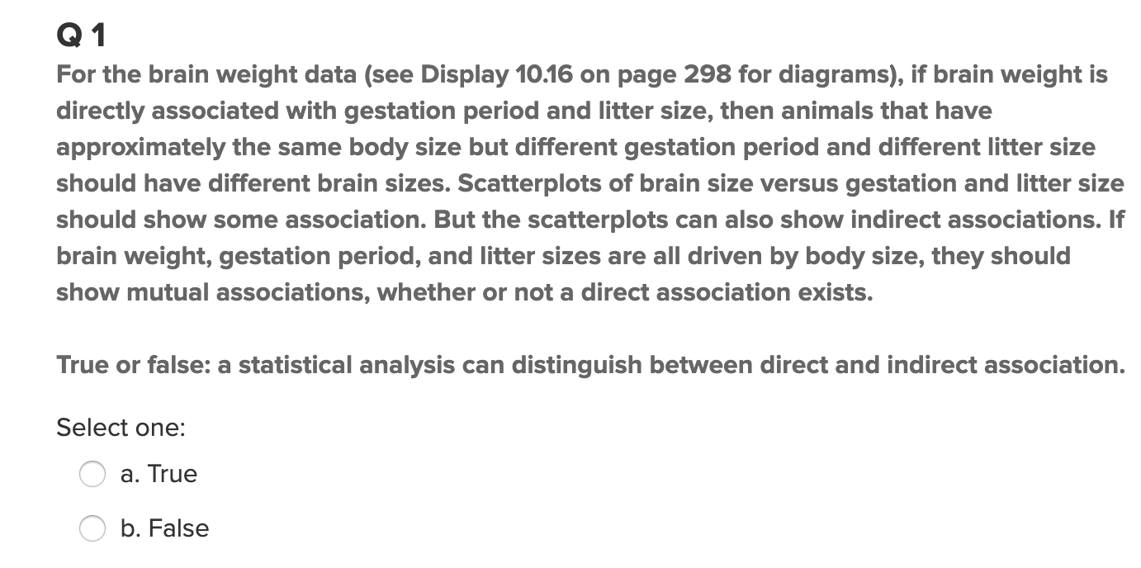
Quick Quiz Questions

Slide 4
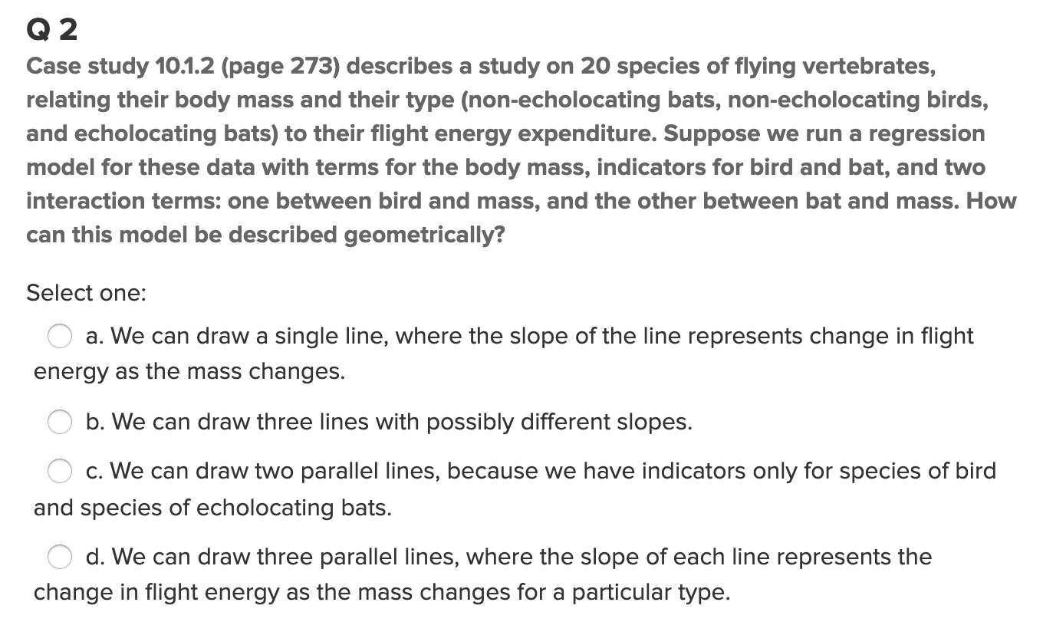
Quick Quiz Questions

Slide 5
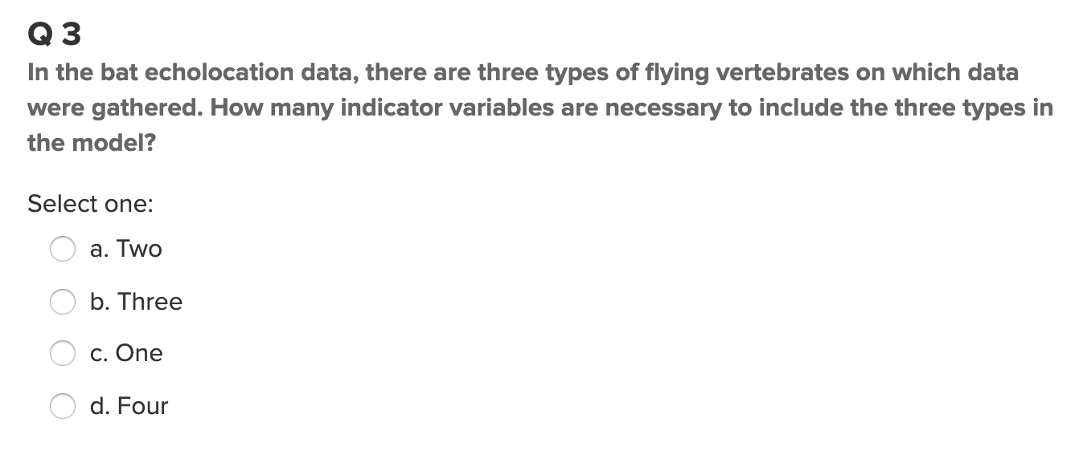
Quick Quiz Questions

Slide 6
End Quick Quiz Questions

Slide 7
Question 1

Slide 8
HSB2 Example
We would like to create a model with a categorical variable for socioeconomic status (SES) in order to test if there is a difference in mean science score for changes between SES = 3 to SES = 1 and SES = 3 to SES =2, taking the math score into account. (Assume math is associated with the science score in the same way for each SES. ) Can we quantify these amounts? That is, by how much can we expect the science score to increase or decrease with respect to SES = 3 (make SES = 3 the reference level). Be sure and write out the model statement and check assumptions!
Now fit a model with flexible slopes and check the assumption above. Is there reason / evidence to believe that the slopes are different between any two SES levels?
Finally, we want to know if and how much the math score is related to the science score after controlling for the reading score. Be sure and write out the model statement and check assumptions!

Slide 9
HSB2 Example
We would like to create a model with a categorical variable for socioeconomic status (SES) in order to test if there is a difference in mean science score for changes between SES = 3 to SES = 1 and SES = 3 to SES =2, taking the math score into account. (Assume math is associated with the science score in the same way for each SES. ) Can we quantify these amounts? That is, by how much can we expect the science score to increase or decrease with respect to SES = 3 (make SES = 3 the reference level). Be sure and write out the model statement and check assumptions!

Slide 10
End Question 1

Slide 11
Question 2

Slide 12
HSB2 Example
We would like to create a model with a categorical variable for socioeconomic status (SES) in order to test if there is a difference in mean science score for changes between SES = 3 to SES = 1 and SES = 3 to SES =2, taking the math score into account. (Assume math is associated with the science score in the same way for each SES. ) Can we quantify these amounts? That is, by how much can we expect the science score to increase or decrease with respect to SES = 3 (make SES = 3 the reference level). Be sure and write out the model statement and check assumptions!
Now fit a model with flexible slopes and check the assumption above. Is there reason / evidence to believe that the slopes are different between any two SES levels?

Slide 13
End Question 2

Slide 14
Question 3

Slide 15
HSB2 Example
We would like to create a model with a categorical variable for socioeconomic status (SES) in order to test if there is a difference in mean science score for changes between SES = 3 to SES = 1 and SES = 3 to SES =2, taking the math score into account. (Assume math is associated with the science score in the same way for each SES. ) Can we quantify these amounts? That is, by how much can we expect the science score to increase or decrease with respect to SES = 3 (make SES = 3 the reference level). Be sure and write out the model statement and check assumptions!
Now fit a model with flexible slopes and check the assumption above. Is there reason / evidence to believe that the slopes are different between any two SES levels?
Finally, we want to know if and how much the math score is related to the science score after controlling for the reading score. Be sure and write out the model statement and check assumptions!

Slide 16
End Question 3

Slide 17
Question 4: Takeaways!
Please provide at least 4 takeaways from this section and any questions that you may have. These questions will help design the live session for this unit.
This question will be the last question of every For Live Session Assignment. The idea is that this deck will serve as a document that you can reference in the future to remember what was covered in this section. For instance, this may come in handy for the Capstone and will hopefully become useful in your career. Most immediately, it may become handy as a quick reference for your Midterm and Final! Some students find it very useful and spend a few slides summarizing the asynch material while others learn different ways and only had the minimum 4 takeaways. Either is fine and will earn you full credit for this question.

Slide 18
Question 5: Questions!
Please provide any question or topics of discussion that came up in this Unit! These will help help us optimize our live session for maximum learning and takeaways!
This question will be the last question of every For Live Session Assignment. The idea is that this deck will serve as a document that you can reference in the future to remember what was covered in this section. For instance, this may come in handy for the Capstone and will hopefully become useful in your career. Most immediately, it may become handy as a quick reference for your Midterm and Final! Some students find it very useful and spend a few slides summarizing the asynch material while others learn different ways and only had the minimum 4 takeaways. Either is fine and will earn you full credit for this question.

Slide 19
End For Live Session Assignment Unit 12!

